Slide 1
OTHER COMBINATIONAL LOGIC CIRCUITS
DECODERS
ENCODERS

Slide 2
DECODER
A decoder is a logic circuit that accepts a set of inputs that represents a binary number and activates only the output that corresponds to the input number.
In other words, a decoder circuit looks at its inputs, determines which binary number is present there, and activates the one output that corresponds to that number ; all other outputs remain inactive

Slide 3
In its general form, a decoder has N input lines to handle N bits and form one to 2 ^{N} output lines to indicate the presence of one or more N-bit combinations.
The basic binary function
An AND gate can be used as the basic decoding element
because it produces a HIGH output only when all inputs are
HIGH
Refer next slide for example

Slide 4
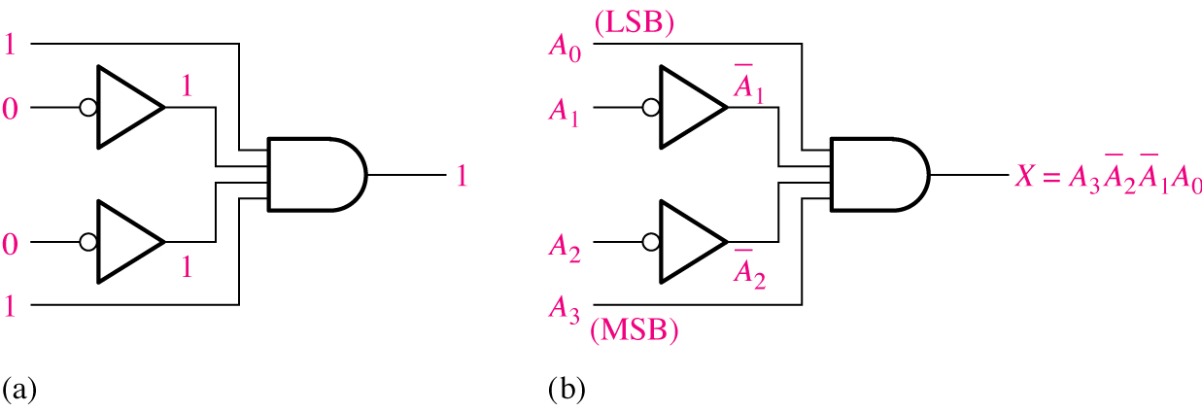
Decoding logic for the binary code 1001 with an active-HIGH output.

Slide 5
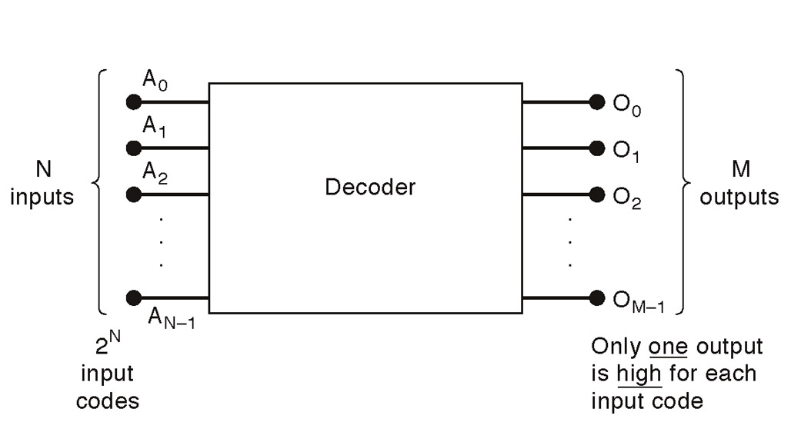
General decoder diagram
# There are 2^{N} possible input combinations, from A₀ to A_{N−1}.
For each of these input combinations only one of the M outputs will be active HIGH (1), all the other outputs are LOW (0).

Slide 6
If an active-LOW output (74138, one of the output will low and the rest will be high) is required for each decoded number, the entire decoder can be implemented with
    NAND gates
    Inverters
If an active-HIGH output (74139, one of the output will high and the rest will be low) is required for each decoded number, the entire decoder can be implemented with
    AND gates
    Inverters

Slide 7
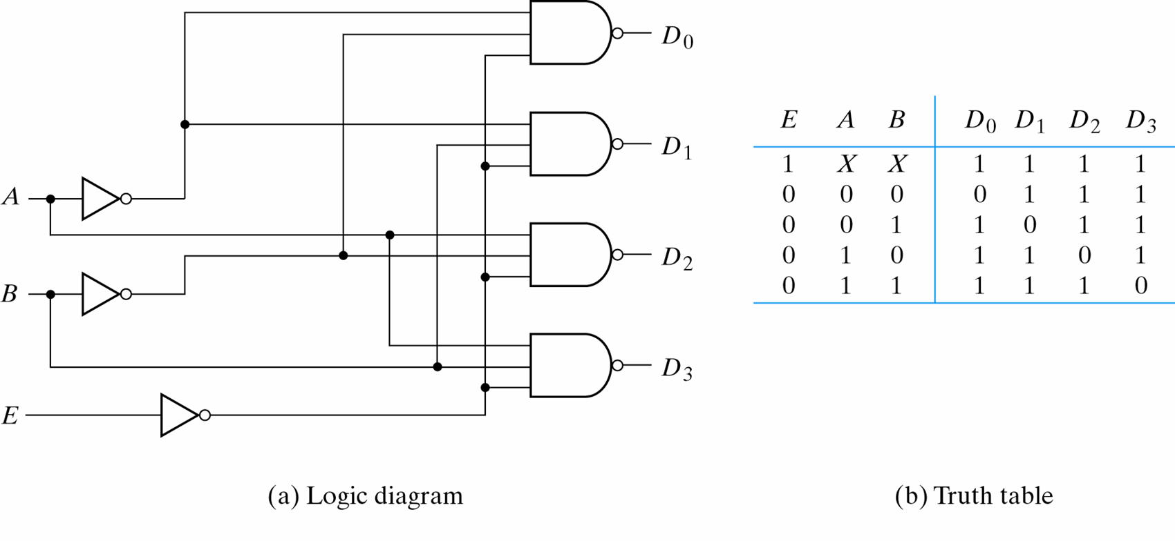
2-to-4-Line Decoder
(with Enable input)-Active LOW output (1)...

Slide 8
2-to-4-Line Decoder
(with Enable input)-Active LOW output (2)
The circuit operates with complemented outputs and a complement enable input. The decoder is enabled when E is equal to 0.
Only one output can be equal to 0 at any given time, all other outputs are equal to 1.
The output whose value is equal to 0 represents the minterm selected by inputs A and B
The circuit is disabled when E is equal to 1.

Slide 9
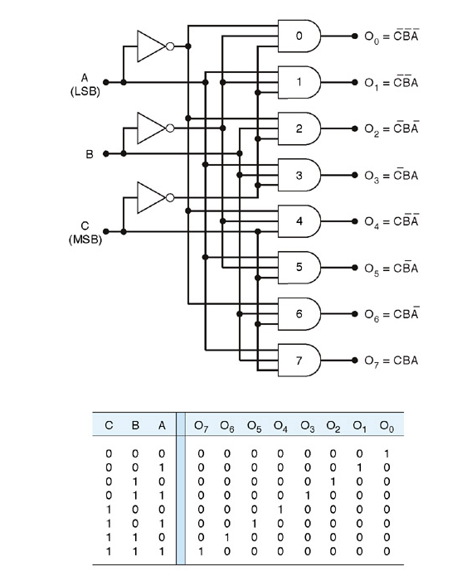
3-8 line decoder (active-HIGH)

Slide 10
This decoder can be referred to in several ways. It can be called a 3-line-to- 8-line decoder, because it has three input lines and eight output lines.
It could also be called a binary-octal decoder or converters because it takes a three bit binary input code and activates the one of the eight outputs corresponding to that code. It is also referred to as a 1-of-8 decoder, because only 1 of the 8 outputs is activated at one time.

Slide 11
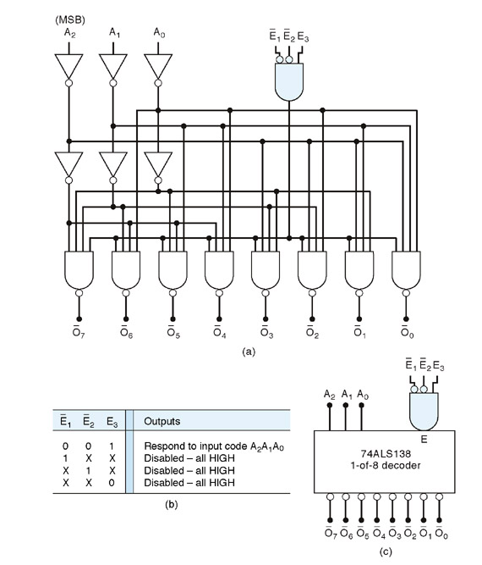
Logic diagram of 74138 (Example of a 3−Bit Decoder)

Slide 12
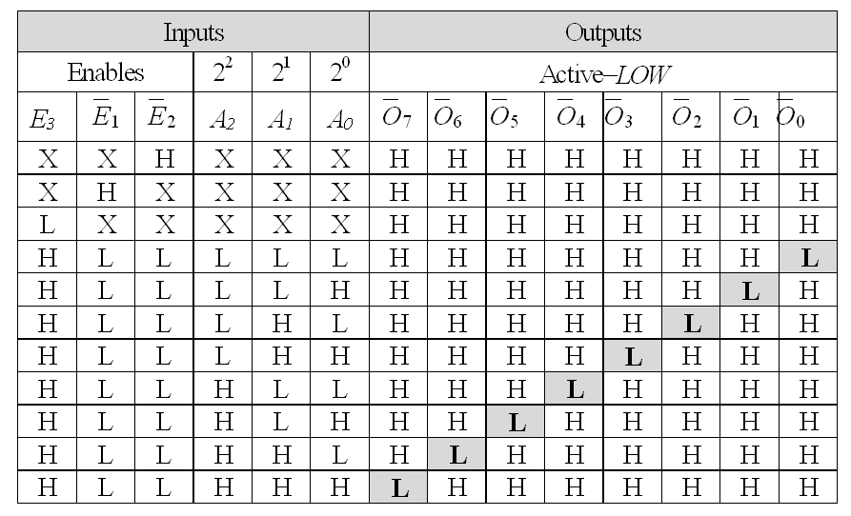
Truth table of 74138 (Example of a 3− 8 Bit Decoder) active-LOW

Slide 13
74138 (Example of a 3− 8 Bit Decoder)
There is an enable function on this device, a LOW level on each input E’₁, and E’₂, and a HIGH level on input E₃, is required in order to make the enable gate output HIGH.
The enable is connected to an input of each NAND gate in the decoder, so it must be HIGH for the NAND gate to be enabled.
If the enable gate is not activated then all eight decoder outputs will be HIGH regardless of the states of the three input variables A₀, A₁, and A₂ .

Slide 14
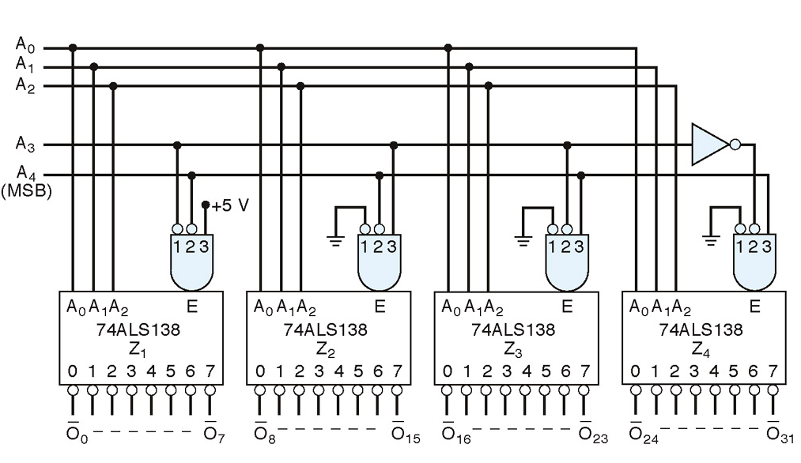
Example of a 5 to 32 Bit Decoder

Slide 15
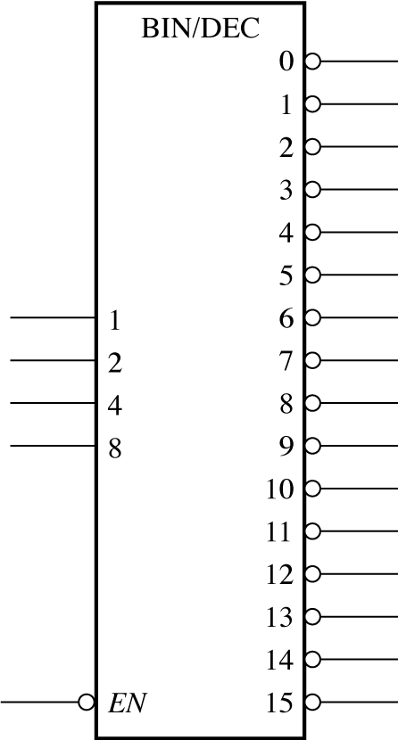
Logic symbol for a 4-line-to-16-line (1-of-16) decoder . 74HC154

Slide 16
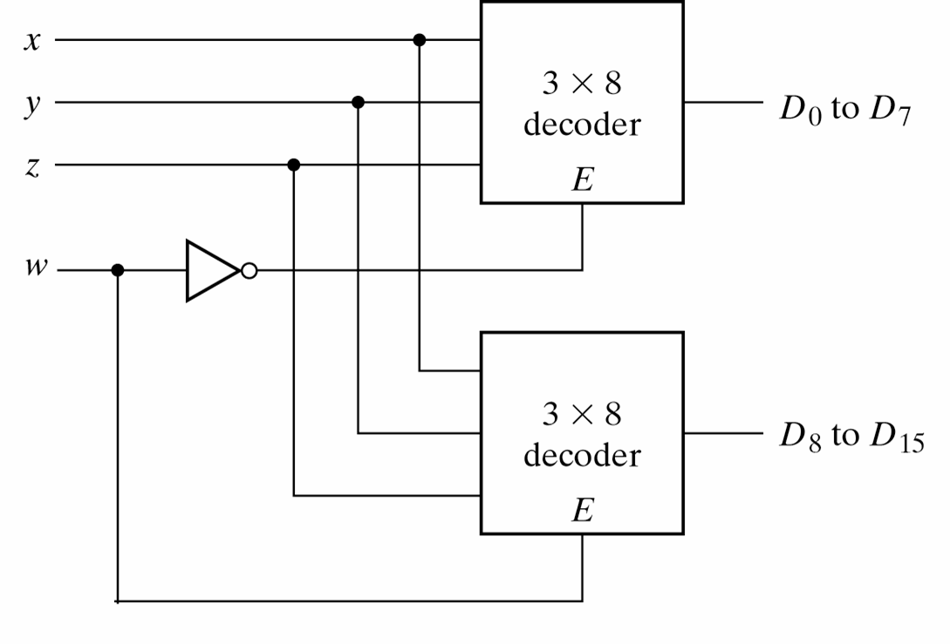
4-line-to-16 line Decoder constructed with two 3-line-to-8 line decoders (1)...

Slide 17
4-line-to-16 line Decoder constructed with two 3-line-to-8 line decoders (2)
When w=0, the top decoder is enabled and the other is disabled. The bottom decoder outputs are all 0’s , and the top eight outputs generate min-terms 0000 to 0111.
When w=1, the enable conditions are reversed. The bottom decoder outputs generate min-terms 1000 to 1111, while the outputs of the top decoder are all 0’s.

Slide 18
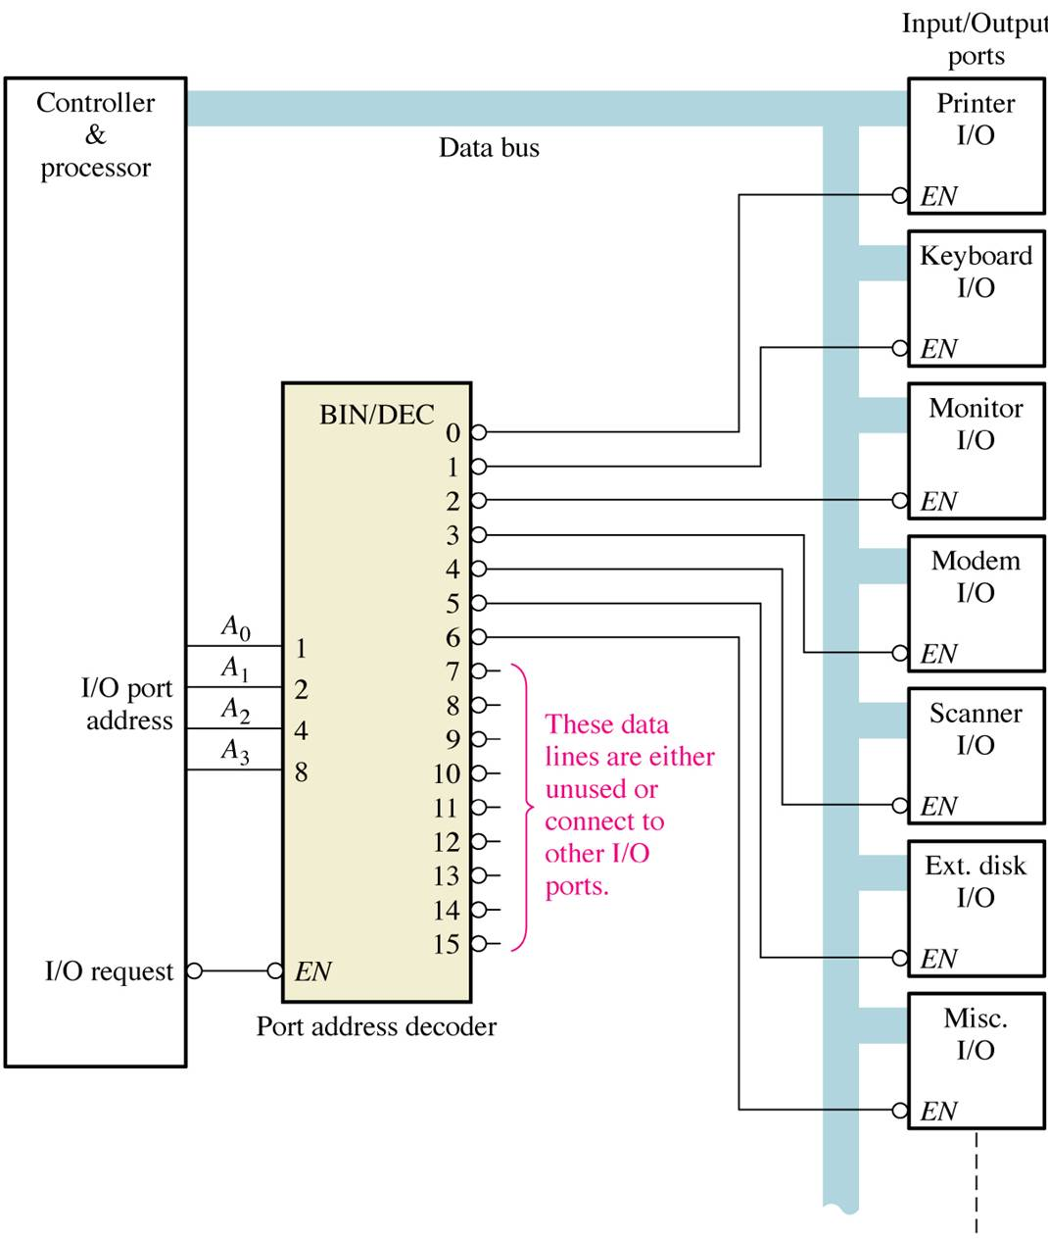
Application example
A simplified computer I/O port system with a port address decoder with only four address lines shown.

Slide 19
Decoders are used in many types of applications. One example is in computers for I/O selection as in previous slide
Computer must communicate with a variety of external devices called peripherals by sending and/or receiving data through what is known as input/output (I/O) ports
Each I/O port has a number, called an address, which uniquely identifies it. When the computer wants to communicate with a particular device, it issues the appropriate address code for the I/O port to which that particular device is connected . The binary port address is decoded and appropriate decoder output is activated to enable the I/O port
Binary data are transferred within the computer on a data bus, which is a set of parallel lines

Slide 20
BCD -to- Decimal decoders
The BCD- to-decimal decoder converts each BCD code into one of Ten Positionable decimal digit indications. It is frequently referred as a 4-line -to- 10 line decoder
The method of implementation is that only ten decoding gates are required because the BCD code represents only the ten decimal digits 0 through 9.
Each of these decoding functions is implemented with NAND gates to provide active -LOW outputs. If an active HIGH output is required, AND gates are used for decoding

Slide 21
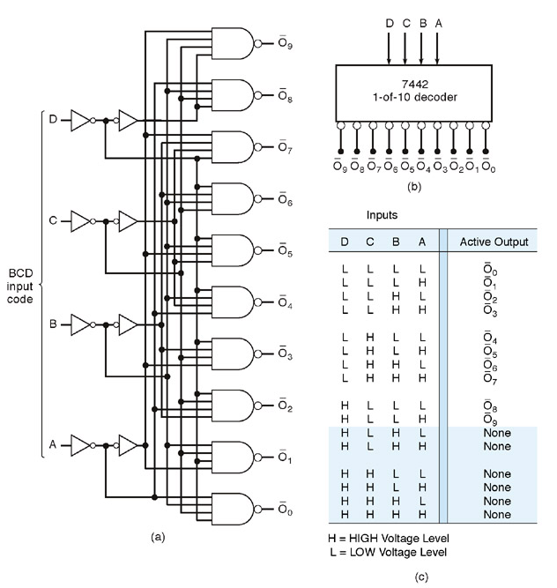
Logic diagram of BCD - decimal decoder
(Active LOW output)

Slide 22
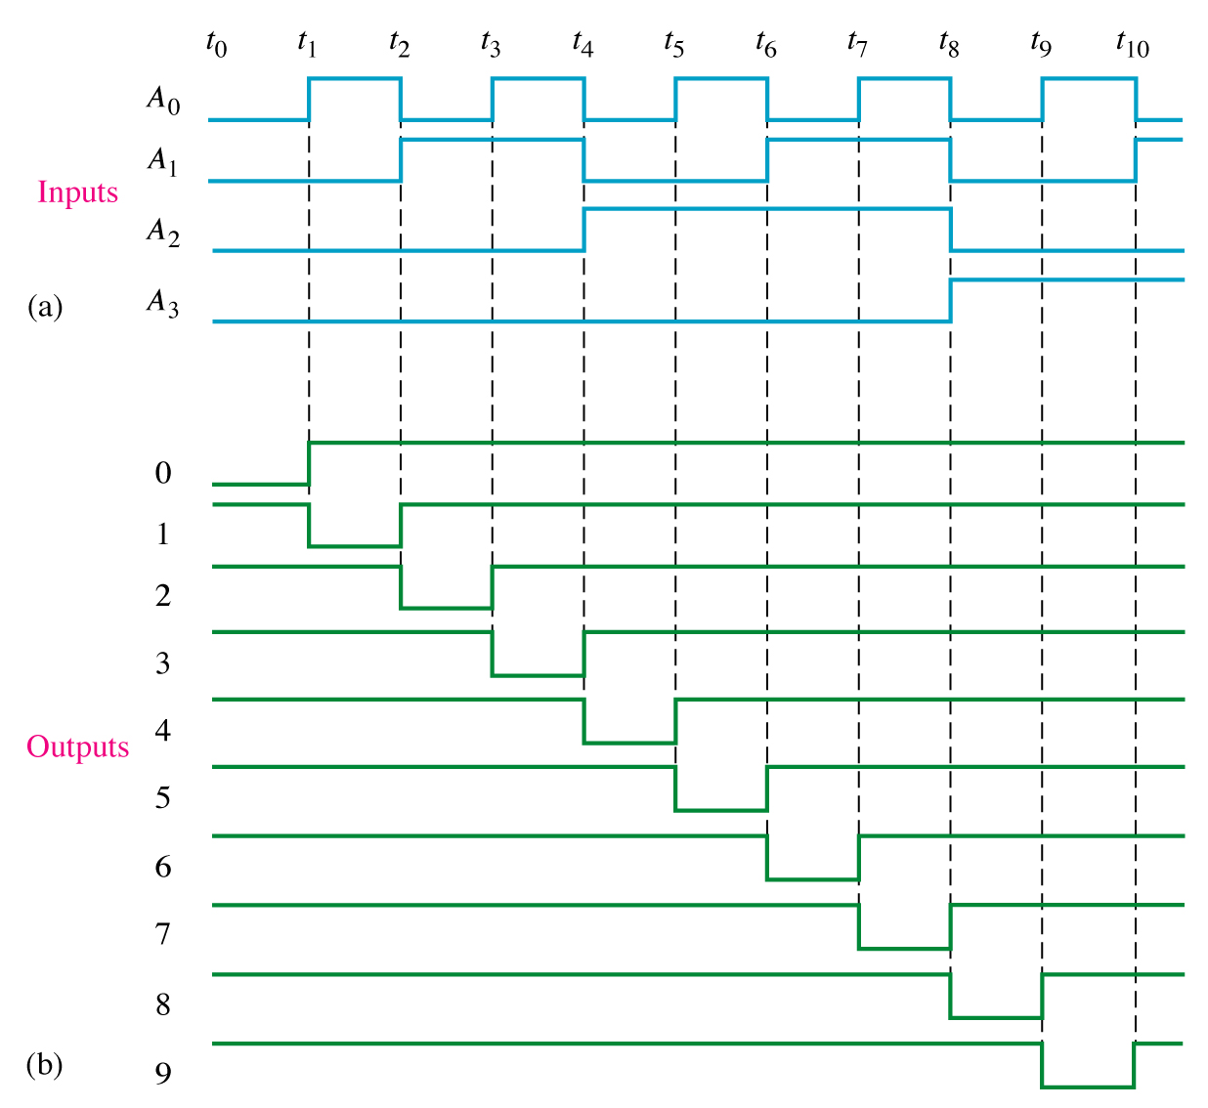
Output Waveform for BCD Decoder

Slide 23
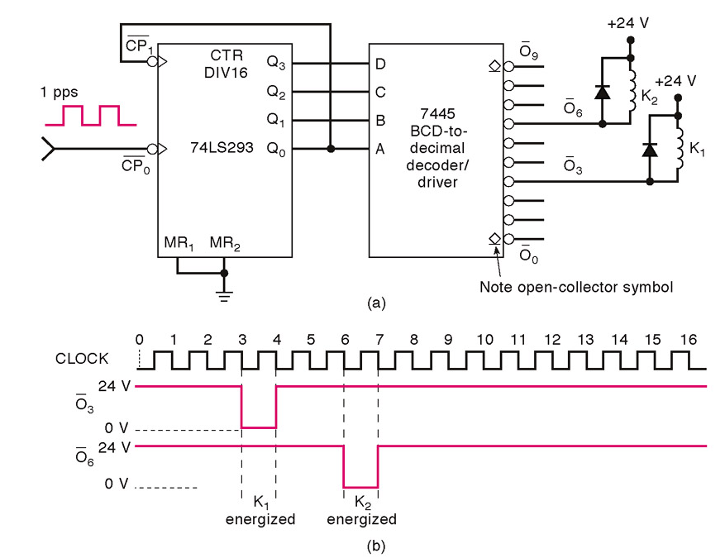
A Decoder Application - Counter -decoder combination used to provide timing and sequential operations (1)...

Slide 24
A Decoder Application - Counter -decoder combination used to provide timing and sequential operations (1)...
Decoders are used whenever an output or a group of outputs is to be activated only on the occurrence of specific combination of input levels. These input levels are often provided by the outputs of a counter or register.
When the decoder inputs come from a counter that is being continually pulsed, the decoder outputs will be activated sequentially, and there can be used as timing or sequencing signals to turn device on or off at specific times

Slide 25
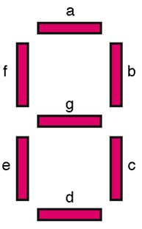
BCD-7segment decoders/drivers
Most digital equipment has some means for displaying information in a form that can be understood by the user. This information is often numerical data but also be alphanumeric.
One of the simplest and most popular methods for displaying numerical digits uses a 7-segment configuration to form digital characters 0 to 9 and some times the hex characters A to F

Slide 26
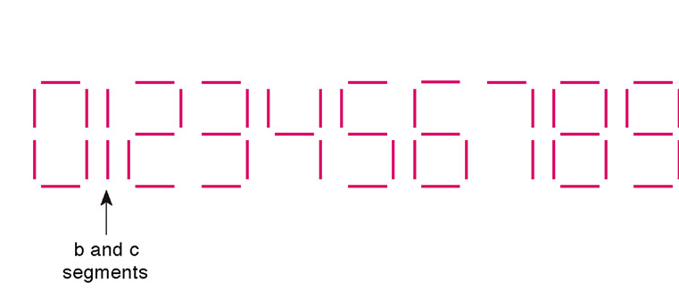
One common arrangements uses light-emitting diodes (LED's) for each segment. By controlling the current thru each LED, some segments will be light and others will be dark so that desired character pattern will be generated
Figure shows the segment pattern that are used to display the various digits. For example, to display a “6” the segments a,c,d,e,f and g are made bright while segment b is dark

Slide 27
7-segment decoder
A BCD-7 segment decoder/driver is used to take four-bit BCD input and provide the outputs that will pass current through the appropriate segments to display the decimal digit.
The logic for this decoder is more complicated than the logic of decoders of earlier case, because each output is activated for more than one combination of inputs.

Slide 28
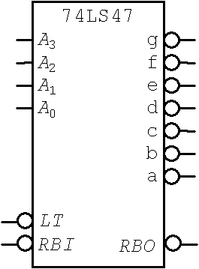
74LS47 ( BCD−to−Seven−Segment Decoder)

Slide 29
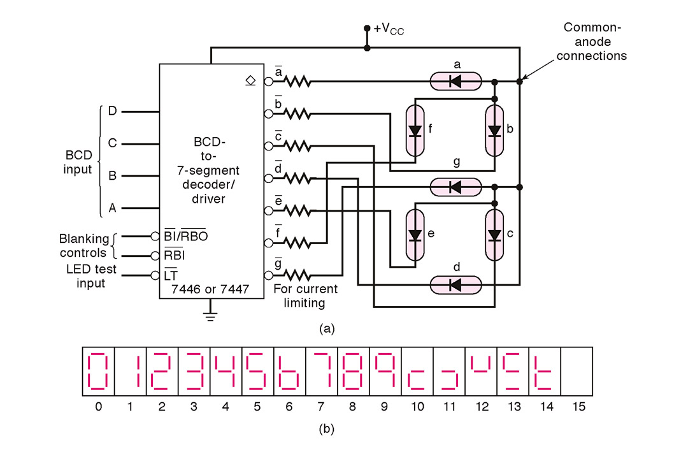

Slide 30
Lamp Test (LT)
When LT = Low, BI/RBO = HIGH then all of the 7 segments in display are turned zero, LT is used to verify that no segments are burned out
Zero Suppression (BI, RBI, RBO)
Zero suppression is a feature used for multi digit displays to blank out unnecessary zeros.
Example:
In a 6-digit display the number 6.4 may be displayed as 006.400 if the zeros are not blanked out

Slide 31
Leading Zero Suppression
Blanking the zeros at the front of a numbers
Trailing Zero Suppression
Blanking the zeros at the back of the number
Only nonessential zeros are blanked, the number 030.080 will be displayed as 30.08 (the essential zeros remain)

Slide 32
7-segment display
There are two types of 7−segment LED displays;
A) common - anode
B) common − cathode

Slide 33
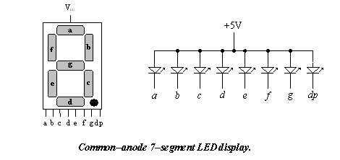
In common−anode, the anode of all of the LEDs are tied together to positive of the power supply (V_{cc}) as shown
Common Anode

Slide 34
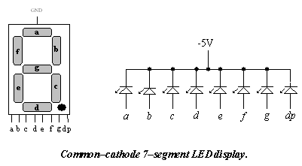
Common Cathode
In common−cathode, the cathode of all of the LEDs are tied together to ground as shown.
GND

Slide 35
Combinational Logic Circuit Implementation using a Decoder
Any combinational logic circuit with n inputs and m outputs can be implemented with an n-to-2n-line decoder and m OR gates.
Procedure:
  Express the given Boolean function in sum of min-terms
  Choose a decoder to generate all the min-terms of the input variables.
  Select the inputs to each OR gate from the decoder outputs according to the list of min-term for each function.

Slide 36
Combinational Logic Circuit Implementation using a Decoder - An example (1)
From the truth table of the full adder,
the functions can be expressed in sum of min-terms.
S(x,y,z) = Σm(1,2,4,7)
C(x,y,z) = Σm(3,5,6,7)
where Σ indicates sum, m indicates min-term and the number in brackets indicate the decimal equivalent
x | y | Z | C | S
0 | 0 | 0 | 0 | 0
0 | 0 | 1 | 0 | 1
0 | 1 | 0 | 0 | 1
0 | 1 | 1 | 1 | 0
1 | 0 | 0 | 0 | 1
1 | 0 | 1 | 1 | 0
1 | 1 | 0 | 1 | 0
1 | 1 | 1 | 1 | 1

Slide 37
Combinational Logic Circuit Implementation using a Decoder - An example (2)
Since there are three inputs and a total of eight min-terms, we need a 3-to-8 line decoder.
The decoder generates the eight min-terms for x,y,z
The OR gate for output S forms the logical sum of min-terms 1,2,4, and 7.
The OR gates for output C forms the logical sum of min-terms 3,5,6, and 7

Slide 38
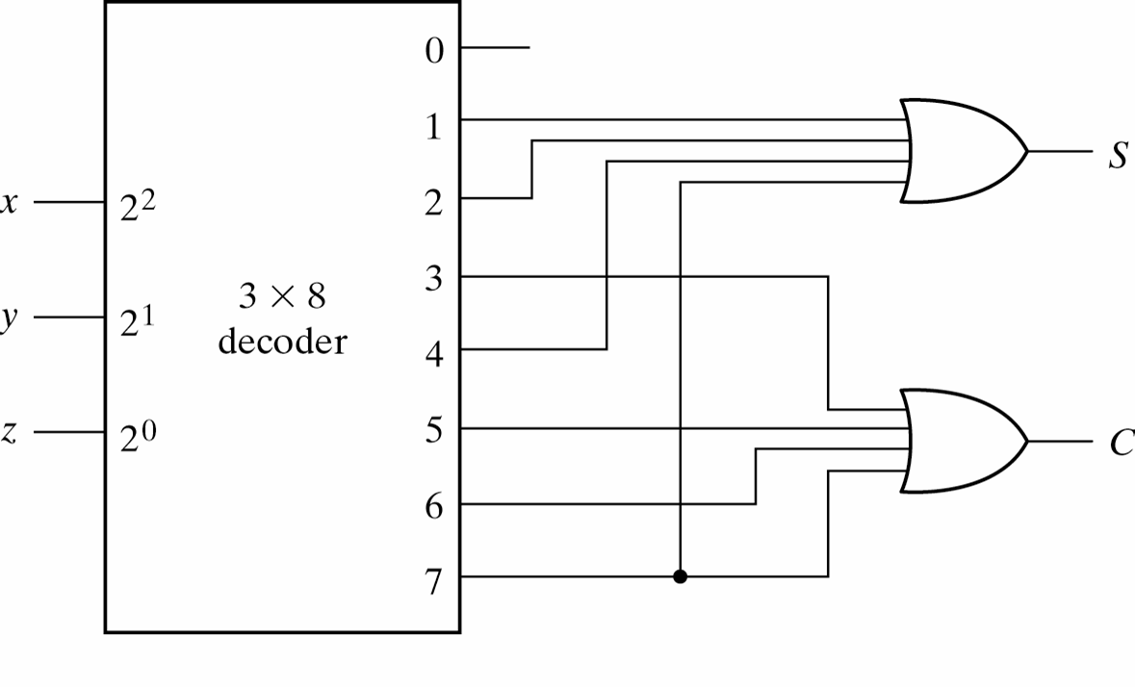
Combinational Logic Circuit Implementation using a Decoder - example (3)
Implementation of a Full Adder with a Decoder

Slide 39
Encoder
An encoder is a combinational logic circuit that essentially performs a “reverse” of decoder functions.
An encoder accepts an active level on one of its inputs, representing digit, such as a decimal or octal digits, and converts it to a coded output such as BCD or binary.
Encoders can also be devised to encode various symbols and alphabetic characters.
The process of converting from familiar symbols or numbers to a coded format is called encoding.

Slide 40
Most decoders accept an input code and produce a HIGH
( or a LOW) at one and only one output line. In otherworlds , a decoder identifies, recognizes, or detects a particular code. The opposite of this decoding process is called encoding and is performed by a logic circuit called an encoder.
An encoder has a number of input lines, only one of which input is activated at a given time and produces an N-bit output code,depending on which input is activated.

Slide 41
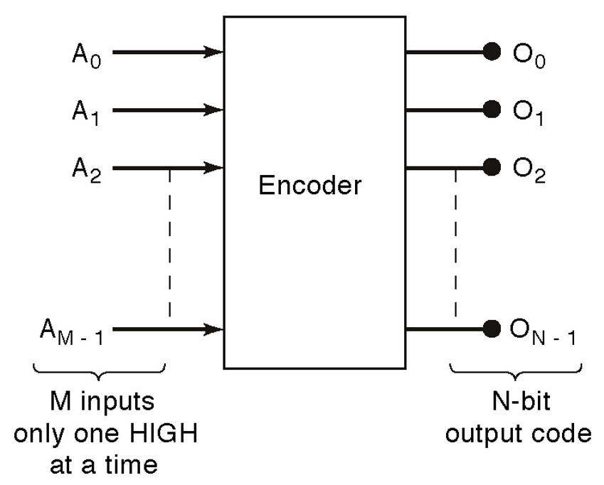
General encoder diagram

Slide 42
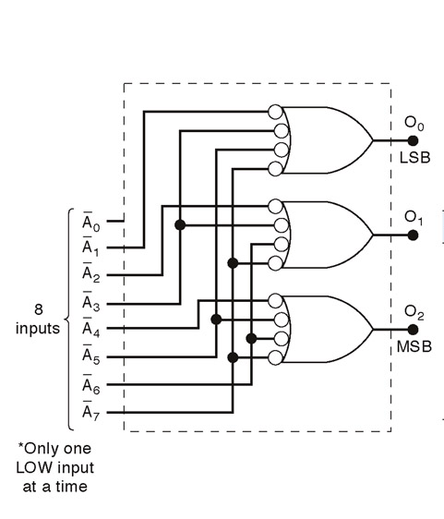
Logic circuit for octal-to binary encoder [8-line- 3-line ]

Slide 43
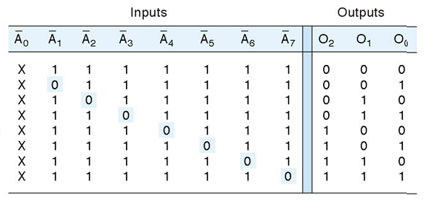
Truth table for octal-to binary encoder [8-line- 3-line ]
A low at any single input will produce the output binary code corresponding to that input. For instance , a low at A₃’ will produce O₂ =0, O₁=1 and O₀ =1, which is binary code for 3. A_{o}’ is not connected to the logic gates because the encoder outputs always be normally at 0000 when none of the inputs is LOW

Slide 44
Design of 4-input Priority Encoder
( 4-line-to 2 line priority encoder) (1)...
A priority encoder is an encoder that includes the priority function
If two or more inputs are equal to 1 at the same time, the input having the highest priority will take precedence.
Truth Table of a 4-input Priority Encoder:
Inputs Outputs
D₀ D₁ D₂ D₃ x y V
0 0 0 0 X X 0
1 0 0 0 0 0 1
X 1 0 0 0 1 1
X X 1 0 1 0 1
X X X 1 1 1 1

Slide 45
Design of 4-input Priority Encoder
( 4-line-to 2 line priority encoder) (2)...
In addition to two outputs x, and y, the truth table has a third output designated by V, which is a valid bit indicator that is set 1 when one or more inputs are equal to 1. If all inputs are 0, there is no valid input and V is equal to 0.
X’s in the output column indicate don’t care conditions, the X’s in the input columns are useful for representing a truth table in condensed form.
The higher the subscript number, the higher the priority of the input. Input D3 has the highest priority, so regardless of the values of the other inputs, when this input is 1, the output for xy is 11 (binary 3)

Slide 46
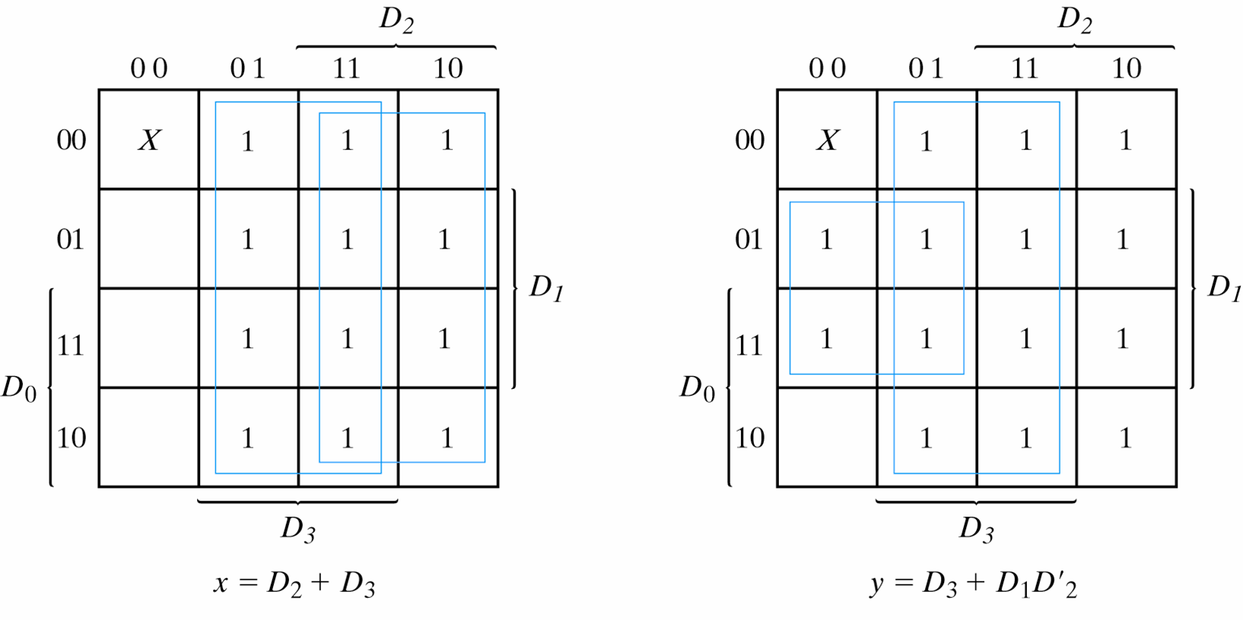
Design of 4-input Priority Encoder
( 4-line-to 2 line priority encoder) (3)...
V=D₀+D₁+D₂+D₃
K-Maps for 4-input Priority Encoder

Slide 47
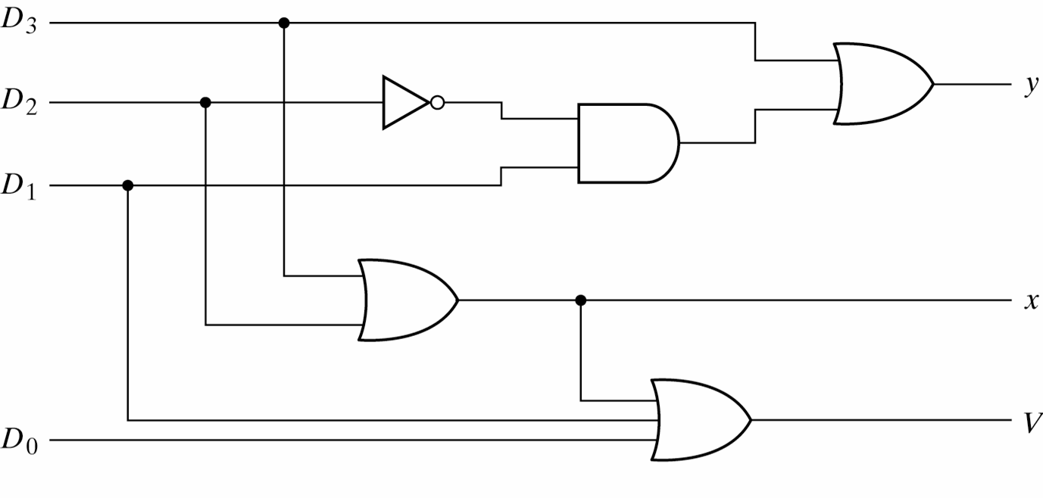
Design of 4-input Priority Encoder
( 4-line-to 2 line priority encoder) (4)
Logic Diagram for 4-input priority encoder

Slide 48
Decimal-BCD priority encoder
Encoder will produce a BCD output corresponding to the highest-order decimal digit input that is active and will ignore any other lower order active inputs.
For instance if the input 6 and the 3 are active, the output will be 1001, which is the inverse value of BCD output 0110 (which represents decimal 6)

Slide 49
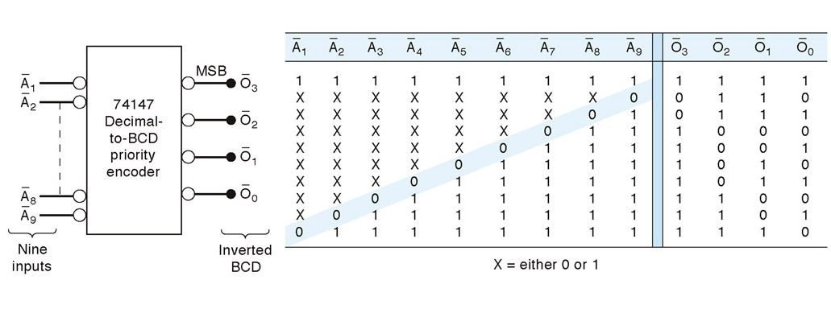
74147 decimal-BCD priority encoder
When A9’ is low, the output is 0110, which is inverse of 1001 ( eq to 9 in BCD)

Slide 50
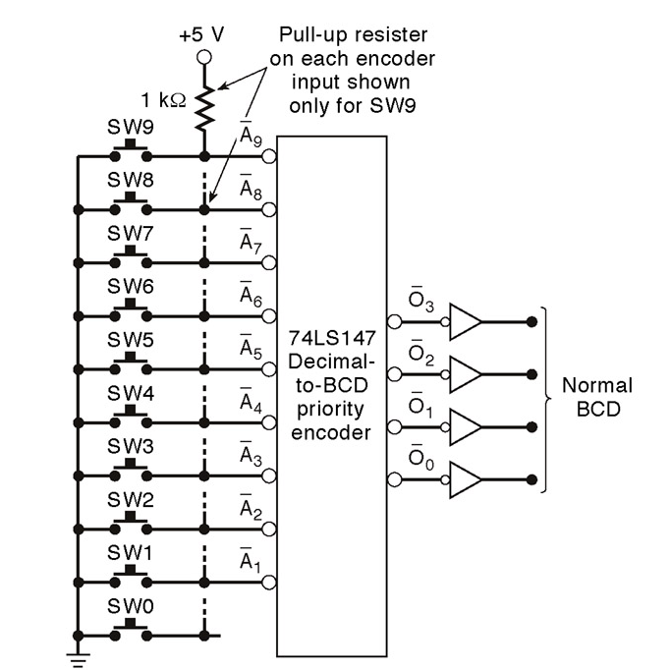
Decimal- BCD switch decoder
The output of the decoder are inversed to produce the normal BCD value

Slide 51
The Octal−to−Binary Priority Encoder-Example
The 74LS148 is a priority encoder that has eight active LOW inputs and three active−LOW binary outputs
To enable the device, the EI (enable input) must be LOW. It also has the EO (enable output) and GS (group signal output) for expansion purposes.

Slide 52
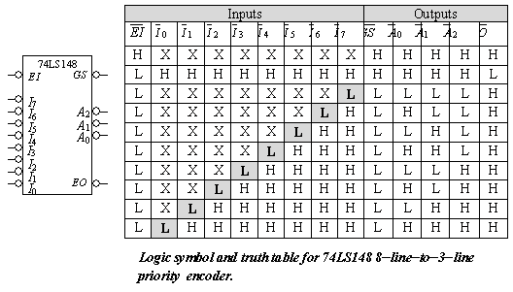
The Octal−to−Binary Encoder

Slide 53
The Octal−to−Binary Encoder
Active−LOW enable input, a HIGH on the input forces all outputs to their inactive state (HIGH).
Active−LOW enable output, the output pin goes LOW when all inputs are inactive (HIGH) and is LOW.
Active−LOW group signal output, this output pin goes LOW whenever any of the inputs are active (LOW) and is LOW.

Slide 54
The 16 −to−4 Encoder
  The 74LS148 can be expanded to a 16−line−to−4−line encoder by connecting the EO of the higher−order encoder to the EI of the lower−order encoder and negative−ORing the corresponding binary outputs as shown

Slide 55
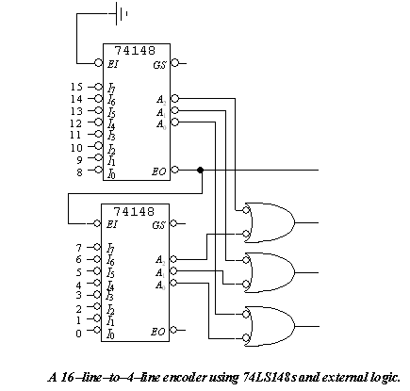
The 16 −to−4 Encoder

Slide 56
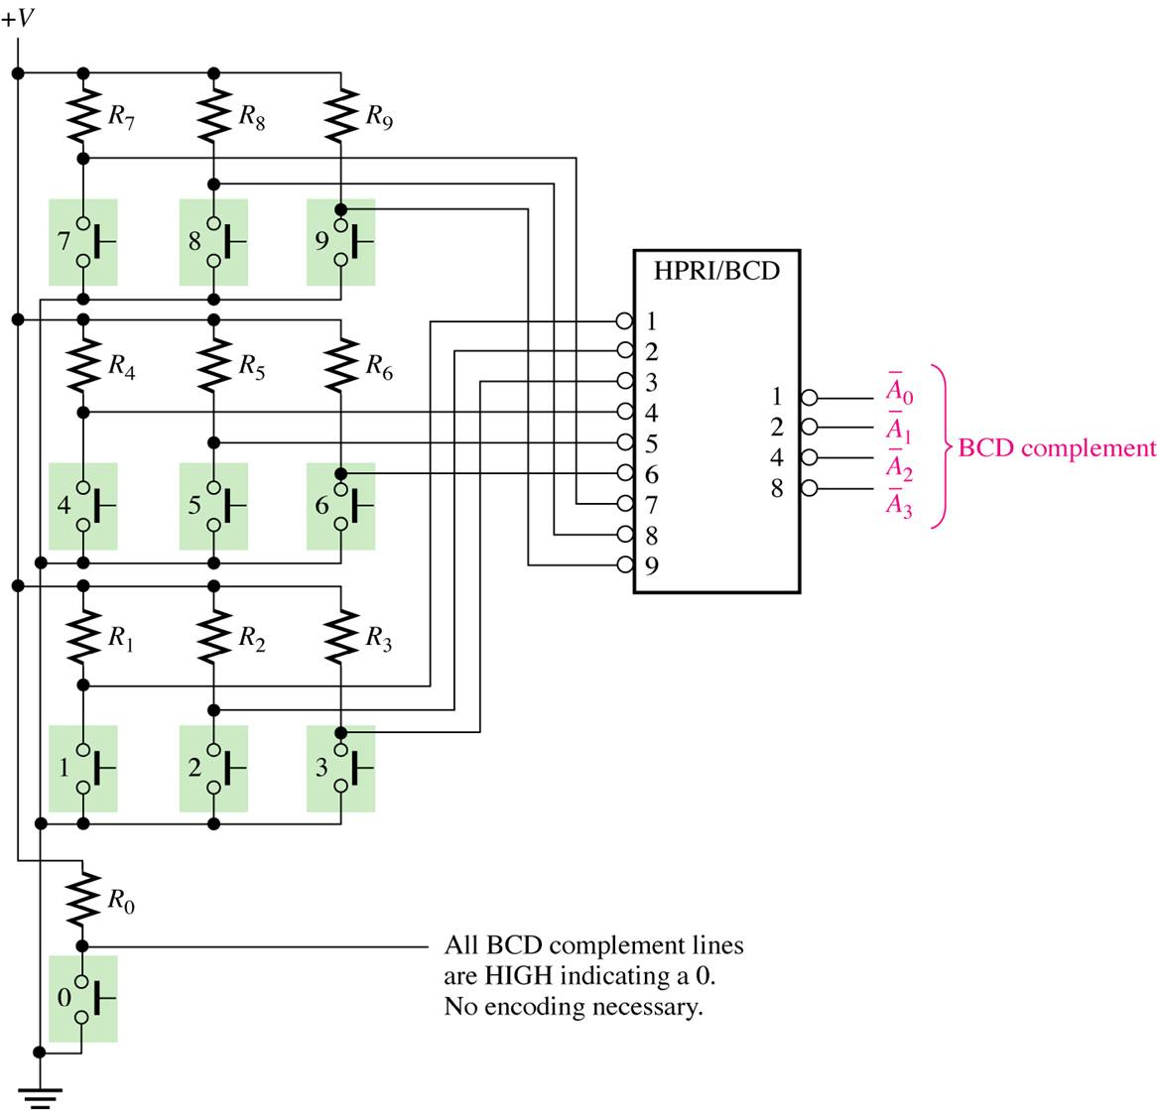
Application example
A simplified keyboard encoder.

Slide 57
When one of the keys is pressed, the decimal digit is encoded to the corresponding BCD code
The keys are represented by 10 push-button switches, each with a pull-up resistor to V+. The pull-up resistor ensures that the line is HIGH when a key is not depressed.
When a key is depressed, the line is connected to ground, and a LOW is applied to the corresponding encoder input.
The zero key is not connected because the BCD output represents zero when none of the other keys is depressed
The BCD complement output of the encoder goes into a storage device, and each successive BCD code is stored until the entire number has been entered

Slide 58
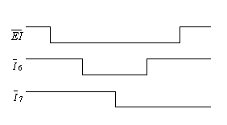
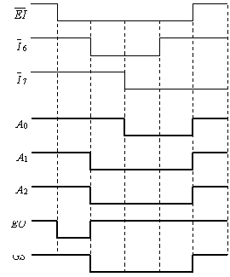
Exercise
Sketch the output waveforms of the 74LS148 encoder based on the given waveforms.
Assume that

